Slide 1

SENTIMENT ANALYSIS
-Manav Gerella
31031421036

Slide 2
Introduction of dataset
Sentiment analysis (or opinion mining) is a natural language processing (NLP) technique used to determine whether data is positive, negative or neutral. Sentiment analysis is often performed on textual data to help businesses monitor brand and product sentiment in customer feedback, and understand customer needs.
The domain of the dataset is based on the social media platform and area is computer.

Slide 3

Problem Statement
Sentiment Analysis is performed to this dataset to check accuracy total number of the Male and Female comments.
1
By doing this, these will help the person how they can improve her quality of content to get more target audience.
2
This will help the content creator to improve and give its best to the community.
3
The comments on popular social media sites are analysed and further classified into positive, negative and neutral comments.
4

Slide 4
Techniques used in the dataset
Importing libraries(numpy, pandas, nltk).
Text-preprocessing includes removing punctuations and stop words, implementing lemmatization and performing POS tagging.
To get the appropriate accuracy we have used
Logistic Regression.
Logistic Regression: It is used calculate or predict the probability of a binary event occurring.

Slide 5
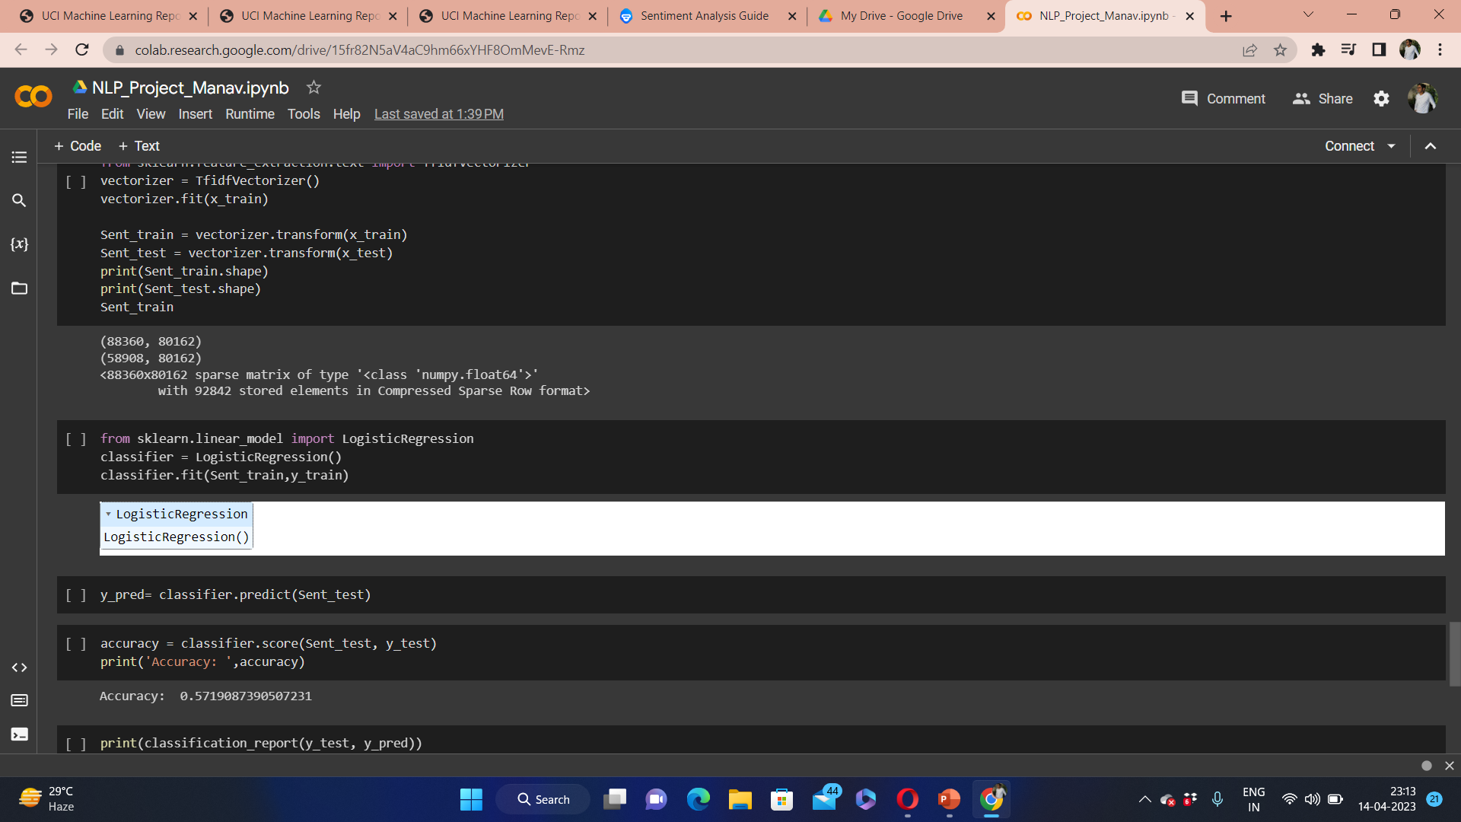
Accuracy

Slide 6
Conclusion
By using Logistic Regression model the appropriate accuracy is achieved.
The accuracy value of model is 57%.
By this we can conclude that Logistic Regression model gives accurate value for doing sentiment analysis of positive and negative comments.
We can get public opinions on any topic by using sentiment analysis platform.

Slide 7
Thank You

